Slide 1

Phone Search Analysis

Slide 2
Table OF contents
1.Introduction
2.Data Description
3.Data Cleaning Steps
4.DashBoard

Slide 3

1. Introduction
In this analysis, we explore a comprehensive data set that contains information about the prices of each product or model of different phones. Through this data, we determine the average prices and ratings from each year in which sales were made for each product.

Slide 4
2.Data Description
Column name | Description
asin | Identification to phone
product_title | Phone name
product_price | Phone price
product_original_price | Original price of phones
Currency | Currency code of the country in which it is sold

Slide 5
2.Data Description
Column name | Description
product_star_rating | Phone rating
product_num_ratings | Number of rating to phones
product_num_offers | Number of offers to each phone
product_minimum_offer_price | Offer the minimum price for each phone
is_best_seller | Best selling phone
is_amazon_choice | From Amazon or not

Slide 6
2.Data Description
Column name | Description
is_prime | prime product or not?
climate_pledge_friendly | Indicates whether the product is environmentally friendly or not.
sales_volume | Sales volume per product
delivery | Time of delivery
has_variations | Indicates whether the product has any differences or not.

Slide 7
3.Data Cleaning Steps
Data cleaning and Data manipulation with Power Bi
Removed Duplicates
Remove Errors
Replace missing data (null) by average
Change data type each column

Slide 8
the business questions using Dax
Average product price
Price variance
Price comparison
Avg star rating
total sales volume
sales per product
number of offers
best sellers count, count the amazon choice products and compare it with the best sellers and other metrics
diff between product minimum offer and original price
calculate the percentage of climate friendly products

Slide 9
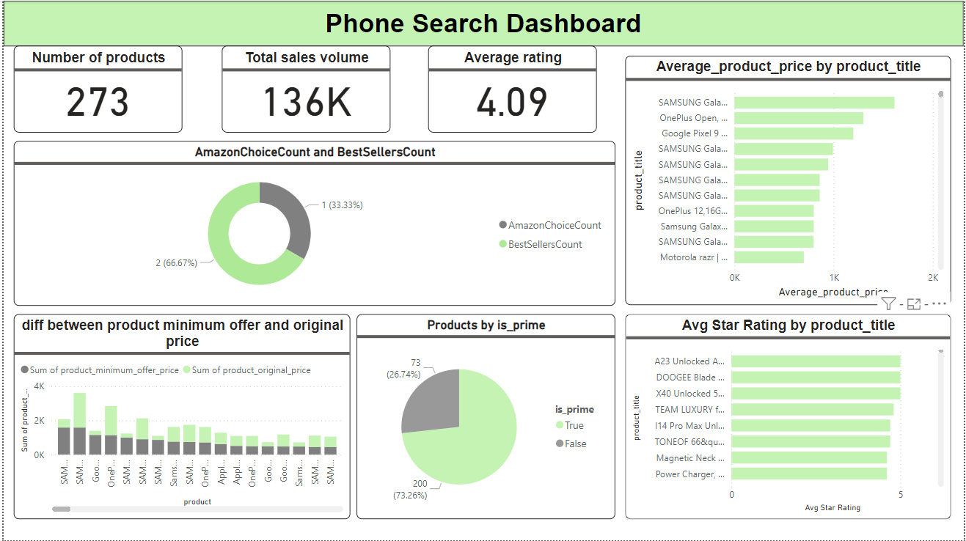
Dashborad

